Slide 1
Machine Learning Enabled Stolen App Detection Framework Employing Decision Tree Models on App Metadata & Behavioral Features for Proactive Security Measures

Slide 2
Abstract
With the increasing use of mobile applications, app theft and unauthorized redistribution have become significant security challenges. Stolen or repackaged applications often contain malicious code, violate intellectual property rights, and pose security risks to users. Traditional detection mechanisms rely on manual inspection or signature-based methods, which are ineffective against sophisticated repackaging techniques. This project proposes a machine learning-enabled stolen app detection framework that employs Decision Tree models to analyze app metadata and behavioral features. By learning patterns that distinguish legitimate apps from stolen or repackaged ones, the system enables proactive detection and enhances mobile application security.

Slide 3
Objective
The main objectives of the proposed system are:
To detect stolen or repackaged mobile applications using machine learning.
To analyze app metadata and behavioral features for classification.
To employ Decision Tree models for explainable detection.
To provide proactive security measures against app piracy.
To protect intellectual property and user security

Slide 4
Introduction
Mobile applications are frequently targeted for theft through repackaging, where attackers modify and redistribute legitimate apps with malicious payloads. Such stolen apps threaten both developers and users by violating copyrights and compromising device security. Existing detection methods struggle to adapt to evolving repackaging techniques. Machine learning offers an effective approach to analyze complex feature patterns within apps. This project introduces an intelligent framework that leverages Decision Tree models to detect stolen applications by examining metadata and runtime behavior, ensuring proactive and automated security.

Slide 5
Existing System
The existing stolen app detection systems mainly use:
Signature-based detection
Hash comparison techniques
Manual code inspection

Slide 6
Disadvantages of Existing System
Ineffective against obfuscated or modified apps.
Requires manual updates and expert intervention.
High false positives and negatives.
Limited scalability.
Cannot detect zero-day repackaged apps.

Slide 7
Proposed System
The proposed system utilizes machine learning-based Decision Tree models to identify stolen applications. App metadata such as package name, developer signature, permissions, and version details are extracted, along with behavioral features like API calls, network access, and file operations. After preprocessing and feature selection, Decision Tree classifiers are trained to distinguish legitimate apps from stolen ones. The system provides explainable detection results and enables proactive security measures such as alerting, blocking, or reporting suspicious apps.

Slide 8
Advantages of Proposed System
Accurate detection of stolen and repackaged apps.
Explainable machine learning decisions.
Automated and scalable framework.
Proactive security response.
Reduces intellectual property theft.
Enhances user and ecosystem security.

Slide 9
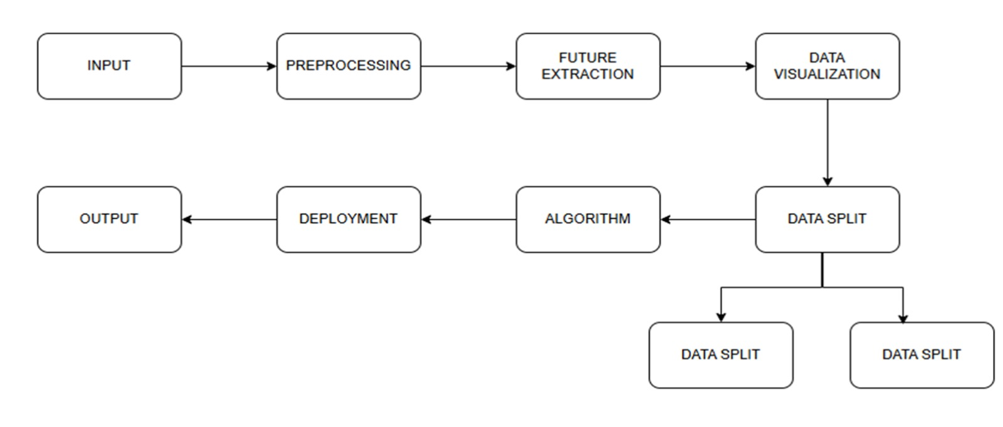
System Architecture

Slide 10
Conclusion
The machine learning-enabled stolen app detection framework effectively addresses the limitations of traditional detection methods by leveraging Decision Tree models and app metadata with behavioral features. The system provides proactive, accurate, and explainable detection of stolen applications, protecting both developers and users. Future work may include ensemble learning, deep learning-based feature extraction, and integration with app store security systems for large-scale deployment.

Slide 11
References
Zhou, Y., & Jiang, X., “Dissecting Android Malware: Characterization and Evolution,” IEEE Symposium on Security and Privacy, 2012.
Crussell, J., et al., “AnDarwin: Scalable Detection of Semantically Similar Android Applications,” ESORICS, 2013.
Wang, P., et al., “Detecting Repackaged Android Applications Using Machine Learning,” IEEE Access, 2019.
Arp, D., et al., “DREBIN: Effective and Explainable Detection of Android Malware,” NDSS, 2014.
Li, L., et al., “A Large-Scale Study on Android App Repackaging,” IEEE Transactions on Software Engineering, 2017.

